Slide 1
Vector Calculus
Lecture 2
Curves continued
The gradient of a scalar field
Surfaces, tangent plane, normal vector
The divergence of a vector field

Slide 2
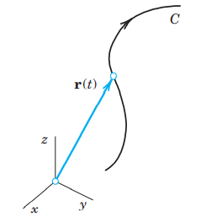
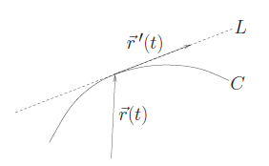
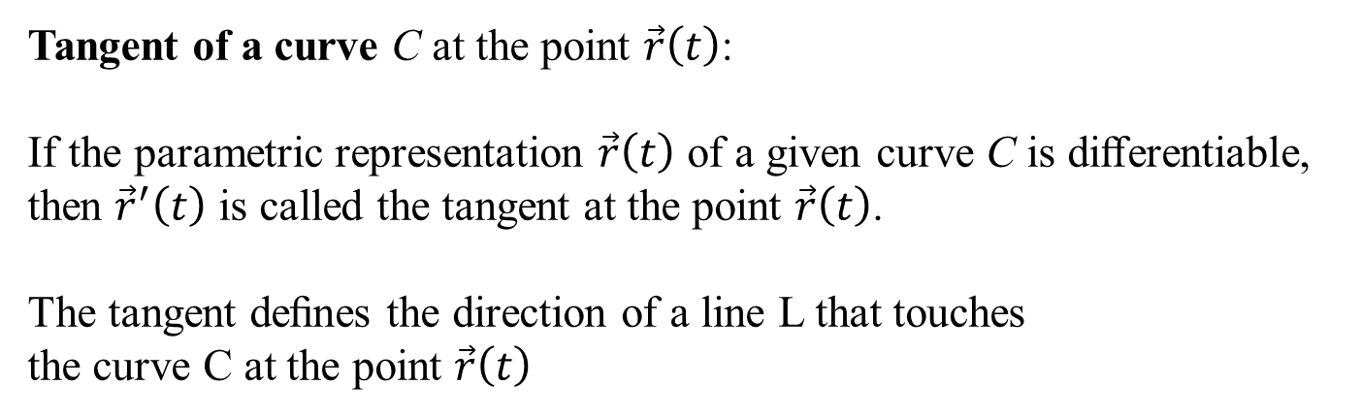
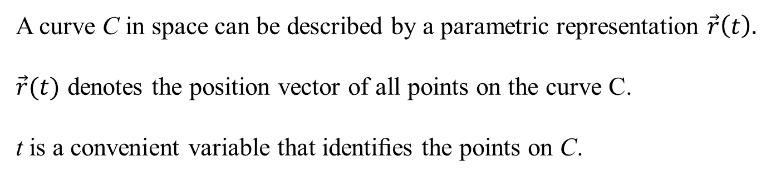
Curves
A curve C in space can be described by a parametric representation $\vec{r}\left(t\right).$
$\vec{r}(t)$ denotes the position vector of all points on the curve C.
t is a convenient variable that identiﬁes the points on C.
E. Kreyszig: Advanced Engeneering Mathematics
Tangent of a curve C at the point $\vec{r}\left(t\right)$:
If the parametric representation $\vec{r}\left(t\right)$ of a given curve C is diﬀerentiable,
then ${\vec{r}}^{′}\left(t\right)$ is called the tangent at the point $\vec{r}\left(t\right)$.
The tangent deﬁnes the direction of a line L that touches
the curve C at the point $\vec{r}\left(t\right)$
J. Schmiegel: Lecture notes

Slide 3

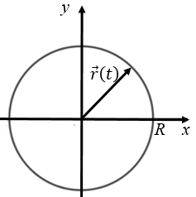
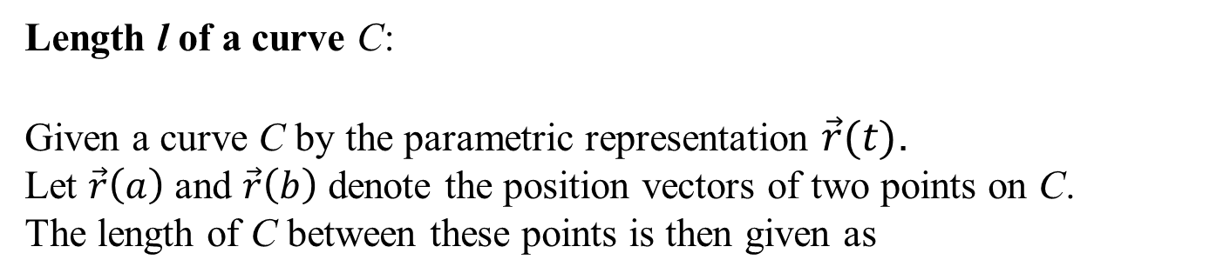
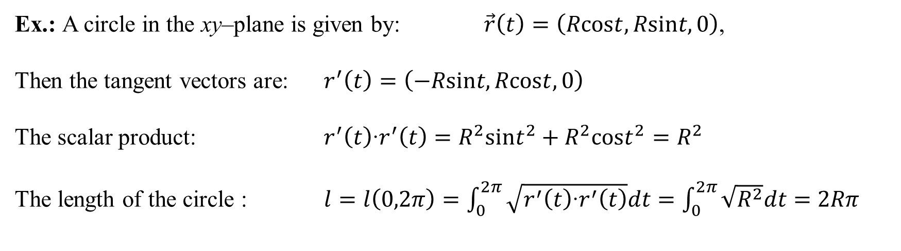
Curves
Length l of a curve C:
Given a curve C by the parametric representation $\vec{r}(t)$.
Let $\vec{r}\left(a\right)$ and $\vec{r}\left(b\right)$ denote the position vectors of two points on C.
The length of C between these points is then given as
Ex.: A circle in the xy–plane is given by: $\vec{r}\left(t\right)=\left(Rcost,Rsint,0\right)$,
Then the tangent vectors are: $r^{′}\left(t\right)=\left(−Rsint,Rcost,0\right)$
The scalar product: $r^{′}\left(t\right)‧r^{′}\left(t\right)=R^{2}{sint}^{2}+R^{2}{cost}^{2}=R^{2}$
The length of the circle : $l=l\left(0,2π\right)=\int_{0}^{2π}{\sqrt{r^{′}\left(t\right)‧r^{′}\left(t\right)}dt=\int_{0}^{2π}{\sqrt{R^{2}}dt=2Rπ}}$

Slide 4
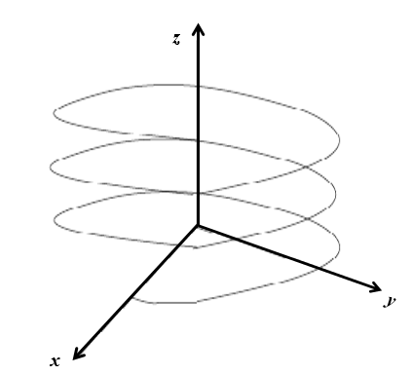
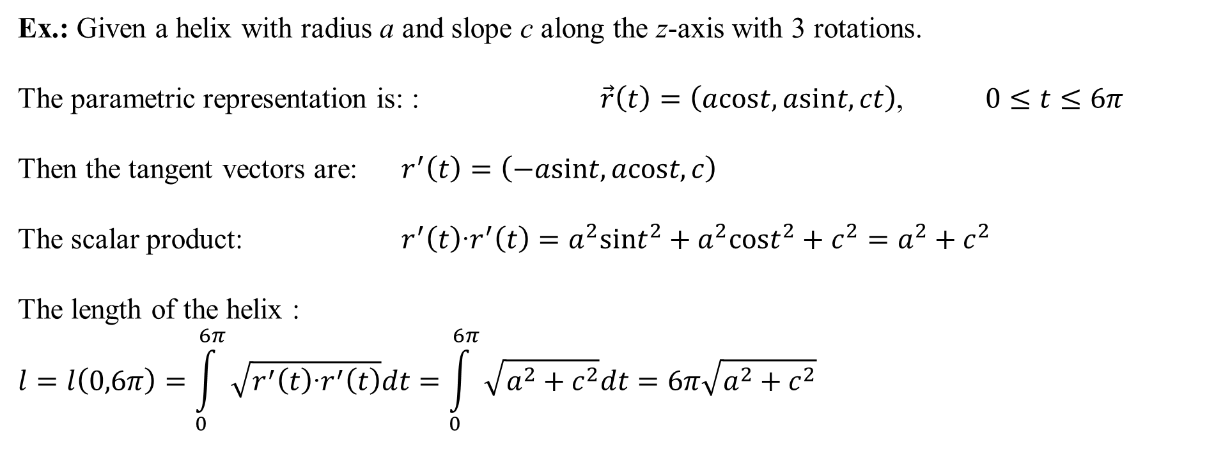



Curves
Ex.: Given a helix with radius a and slope c along the z-axis with 3 rotations.
The parametric representation is: : $\vec{r}\left(t\right)=\left(acost,asint,ct\right)$, $0≤t≤6π$
Then the tangent vectors are: $r^{′}\left(t\right)=\left(−asint,acost,c\right)$
The scalar product: $r^{′}\left(t\right)‧r^{′}\left(t\right)=a^{2}{sint}^{2}+a^{2}{cost}^{2}+c^{2}=a^{2}+c^{2}$
The length of the helix :
$$l=l\left(0,6π\right)=\int_{0}^{6π}{\sqrt{r^{′}\left(t\right)‧r^{′}\left(t\right)}dt=\int_{0}^{6π}{\sqrt{a^{2}+c^{2}}dt=6π\sqrt{a^{2}+c^{2}}}}$$
c6$π$
c4$π$
c2$π$

Slide 5
Vector Calculus
The gradient of a scalar field

Slide 6
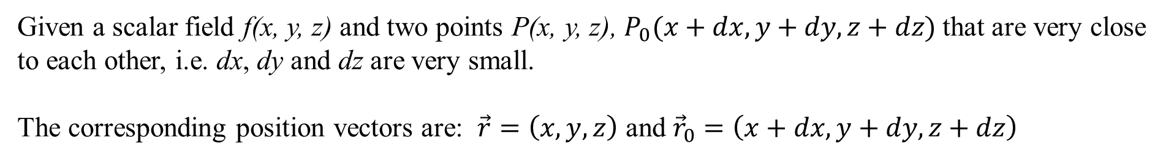



Taylor expansion
Given a scalar field f(x, y, z) and two points P(x, y, z), $P_{0}(x+dx, y+dy, z+dz)$that are very close to each other, i.e. dx, dy and dz are very small.
The corresponding position vectors are: $\vec{r}=\left(x,y,z\right)$ and ${\vec{r}}_{0}=\left(x+dx, y+dy, z+dz\right)$
Then the Taylor expansion gives:
+ ...
higher order terms in dx; dy; dz
P
$$\vec{r}$$
$$P_{0}$$
$${\vec{r}}_{0}$$

Slide 7

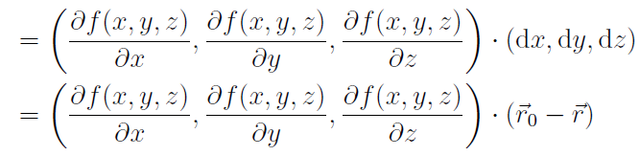
Taylor expansion
The higher order terms can be neglected for $dx⟶0, dy ⟶0 and dz ⟶ 0$.
P
$$\vec{r}$$
$$P_{0}$$
$${\vec{r}}_{0}$$

Slide 8

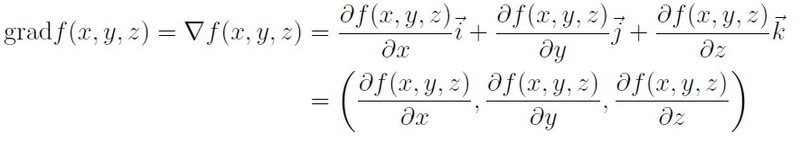

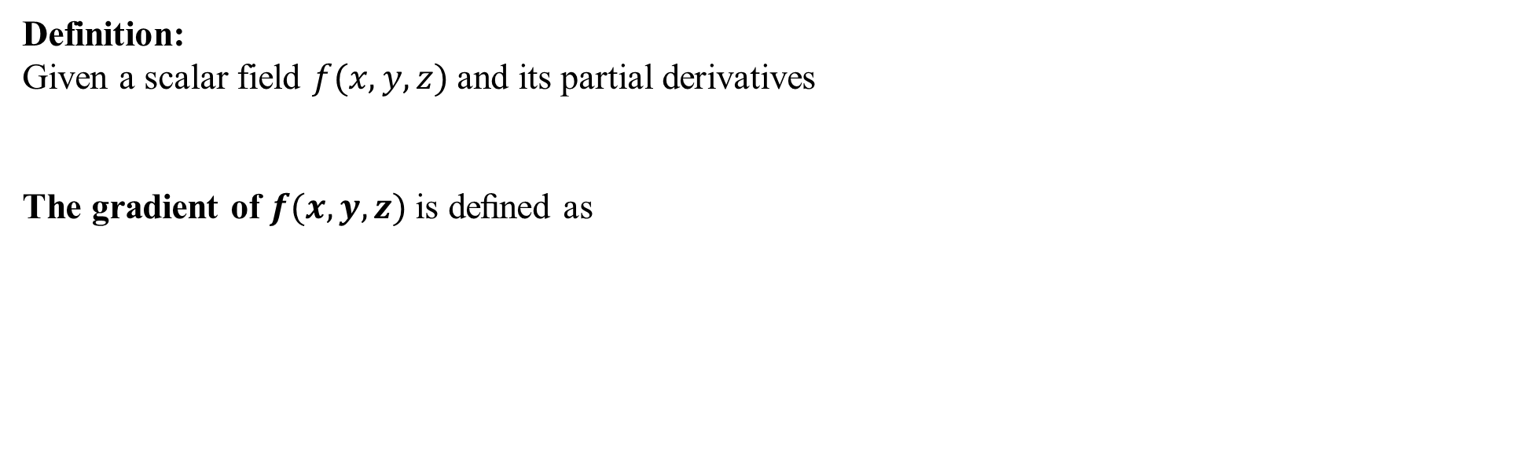
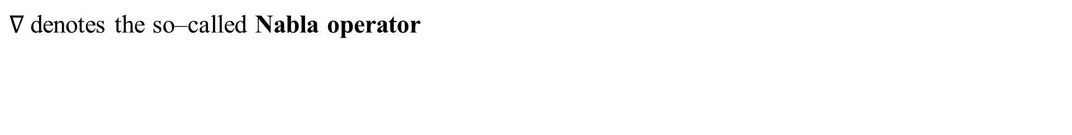
The gradient of a scalar ﬁeld
Definition:
Given a scalar field $f(x,y,z)$and its partial derivatives
The gradient of $f(x, y, z)$is deﬁned as
$∇$denotes the so–called Nabla operator
Note that the gradient of the scalar field f is a vector field

Slide 9


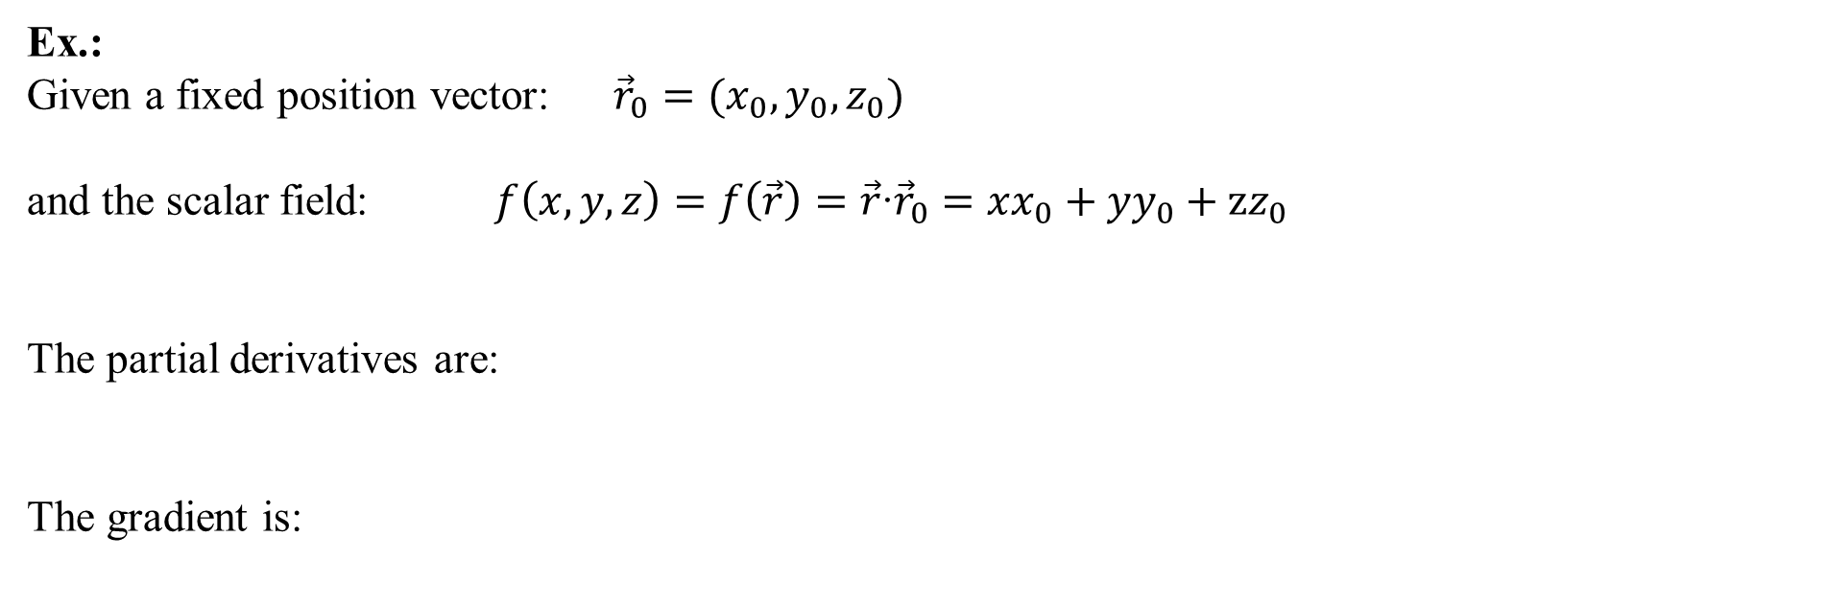
The gradient of a scalar ﬁeld
Ex.:
Given a fixed position vector: ${\vec{r}}_{0}=(x_{0},y_{0},z_{0})$
and the scalar field: $f\left(x,y,z\right)=f\left(\vec{r}\right)=\vec{r}‧{\vec{r}}_{0}=xx_{0}+yy_{0}+zz_{0}$
The partial derivatives are:
The gradient is:

Slide 10




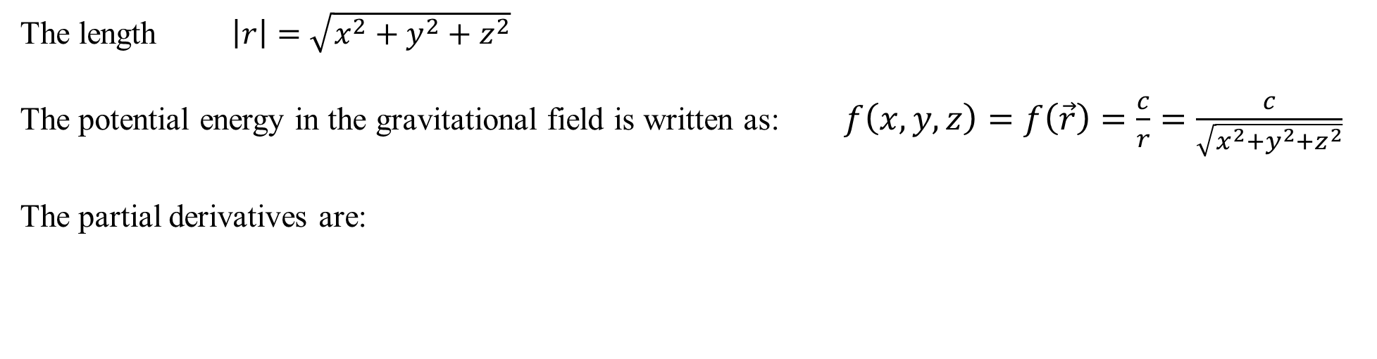

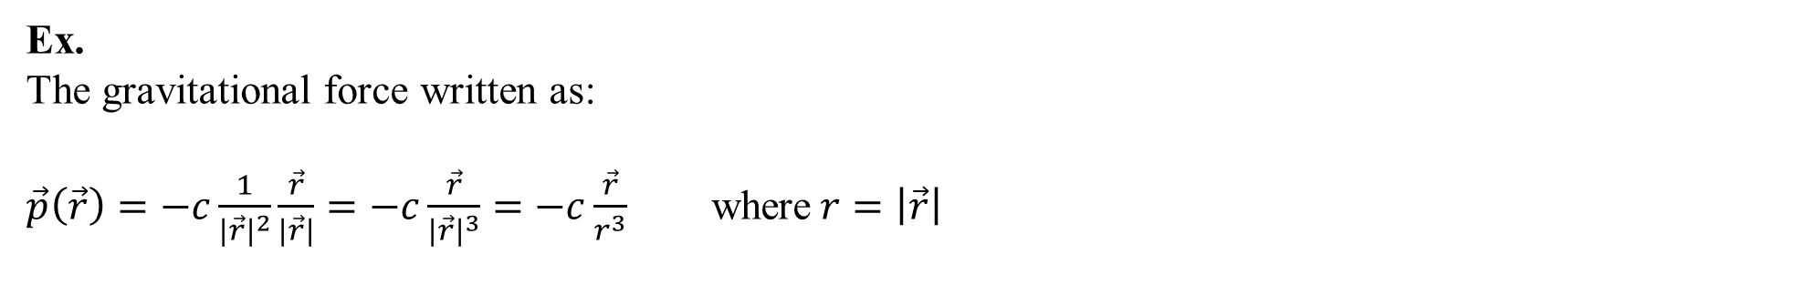

The gradient of a scalar ﬁeld
Ex.
The gravitational force written as:
$\vec{p}\left(\vec{r}\right)=−c\frac{1}{{\left|\vec{r}\right|}^{2}}\frac{\vec{r}}{\left|\vec{r}\right|}=−c\frac{\vec{r}}{{\left|\vec{r}\right|}^{3}}=−c\frac{\vec{r}}{r^{3}}$ where$r=\left|\vec{r}\right|$
$$\vec{p}\left(\vec{r}\right)$$
$$\frac{\vec{r}}{\left|\vec{r}\right|}$$
$$\left|\vec{r}\right|$$
The length $\left|r\right|=\sqrt{x^{2}+y^{2}+z^{2}}$
The potential energy in the gravitational field is written as: $f\left(x,y,z\right)=f\left(\vec{r}\right)=\frac{c}{r}=\frac{c}{\sqrt{x^{2}+y^{2}+z^{2}}}$
The partial derivatives are:

Slide 11
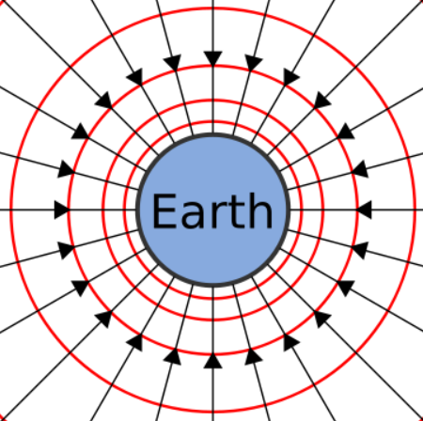

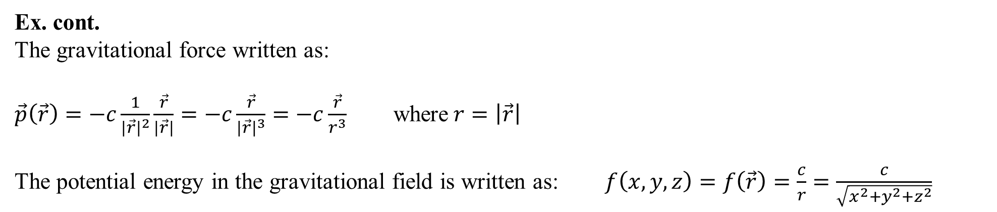
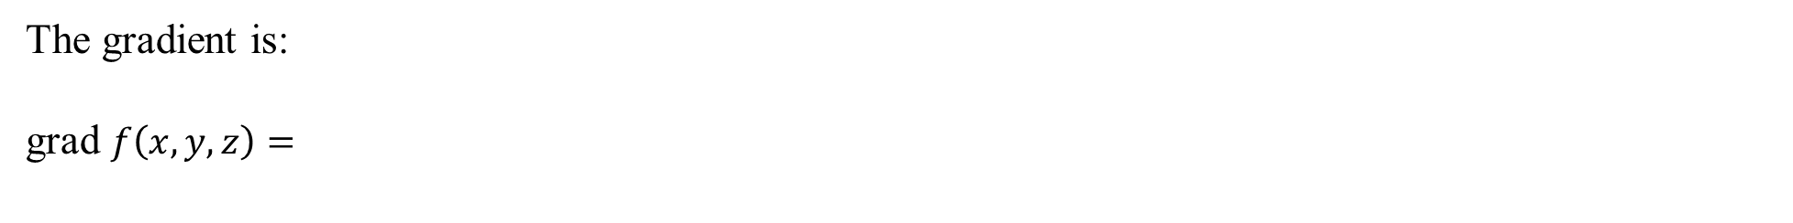
The gradient of a scalar ﬁeld
Ex. cont.
The gravitational force written as:
$\vec{p}\left(\vec{r}\right)=−c\frac{1}{{\left|\vec{r}\right|}^{2}}\frac{\vec{r}}{\left|\vec{r}\right|}=−c\frac{\vec{r}}{{\left|\vec{r}\right|}^{3}}=−c\frac{\vec{r}}{r^{3}}$ where$r=\left|\vec{r}\right|$
The potential energy in the gravitational field is written as: $f\left(x,y,z\right)=f\left(\vec{r}\right)=\frac{c}{r}=\frac{c}{\sqrt{x^{2}+y^{2}+z^{2}}}$
$$\vec{p}\left(\vec{r}\right)$$
$$\frac{\vec{r}}{\left|\vec{r}\right|}$$
$$\left|\vec{r}\right|$$
The gradient is:
grad $f\left(x,y,z\right)=$
https://www.toppr.com/ask/content/concept/equipotential-surfaces-209413/
i.e. the gravitational force $\vec{p}$is the gradient of the scalar field f
: equipotential surfaces

Slide 12
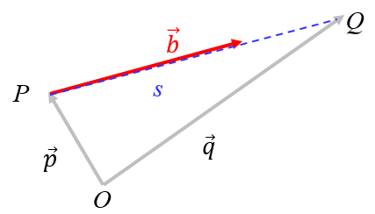
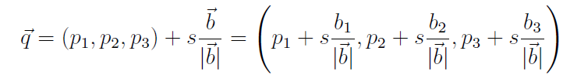



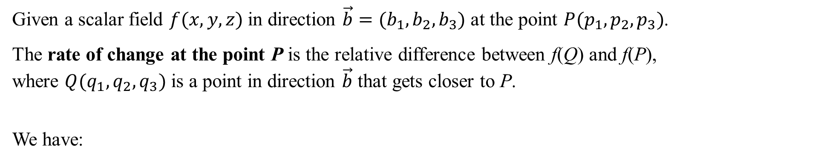
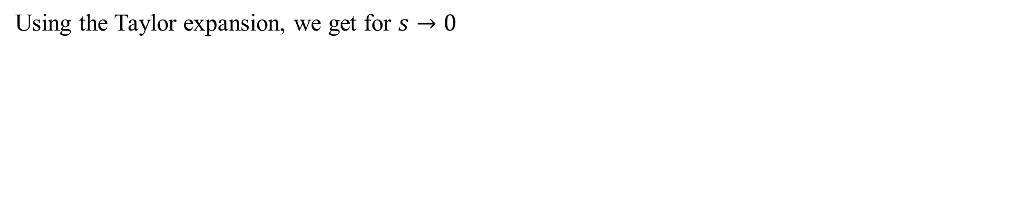
Directional derivative
Given a scalar field $f(x,y,z)$in direction $\vec{b}=(b_{1},b_{2},b_{3})$ at the point ${P(p}_{1},p_{2},p_{3})$.
The rate of change at the point P is the relative difference between f(Q) and f(P),
where ${Q(q}_{1},q_{2},q_{3})$ is a point in direction $\vec{b}$ that gets closer to P.
We have:
Using the Taylor expansion, we get for $s→0$
The rate of change at the point P is:

Slide 13



Directional derivative
Ex.:
Given: the scalar field $f\left(x,y,z\right)=2x^{2}+3y^{2}+z^{2}$ and $\vec{b}=(1,0,−2)$ and $P(2,1,3)$
Then
and
The directional derivative
$D_{\vec{b}}f\left(P\right)=\frac{\vec{b}∙∇f(P)}{\left|\vec{b}\right|}=\frac{(1,0,−2)∙(8,6,6)}{\sqrt{5}}=\frac{8+0−12}{\sqrt{5}}=−\frac{4}{\sqrt{5}}$
The sign – tells, that f is decreasing at P in the direction of $\vec{b}$.

Slide 14
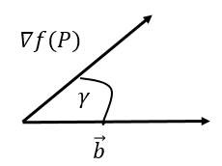

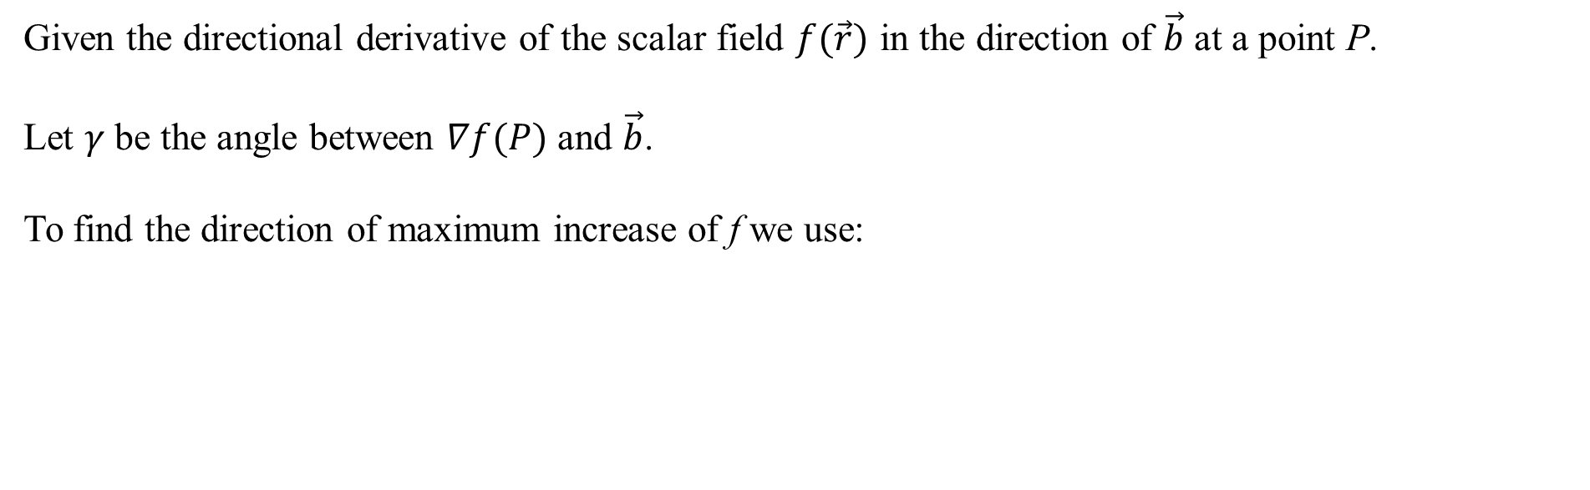
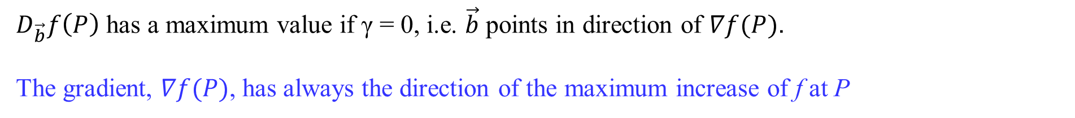
Direction of maximum increase
Given the directional derivative of the scalar field $f(\vec{r})$ in the direction of $\vec{b}$ at a point P.
Let $γ$ be the angle between $∇f(P)$ and $\vec{b}$.
To find the direction of maximum increase of f we use:
$D_{\vec{b}}f\left(P\right)$ has a maximum value if γ = 0, i.e. $\vec{b}$ points in direction of $∇f(P)$.
The gradient, $∇f(P)$, has always the direction of the maximum increase of f at P

Slide 15
Vector Calculus
Surfaces, tangent plane, normal vector

Slide 16
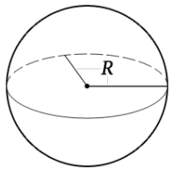

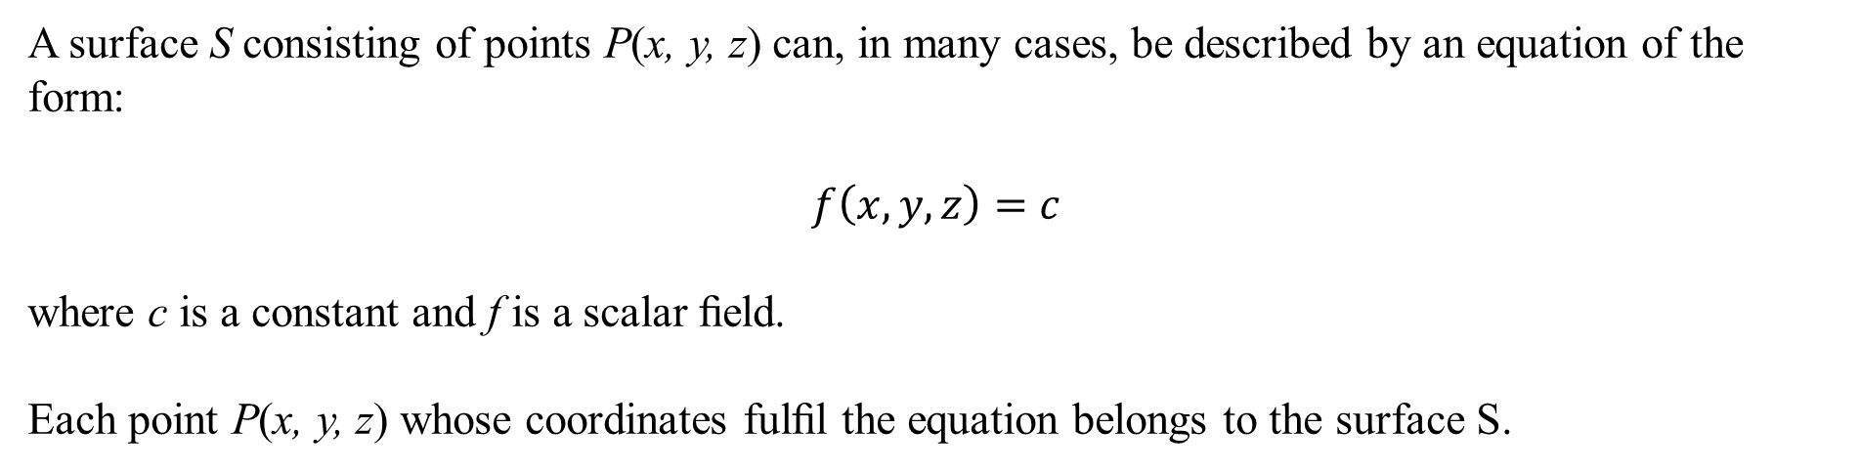
Surfaces
A surface S consisting of points P(x, y, z) can, in many cases, be described by an equation of the form:
$$f\left(x,y,z\right)=c$$
where c is a constant and f is a scalar ﬁeld.
Each point P(x, y, z) whose coordinates fulﬁl the equation belongs to the surface S.
Ex
A sphere with radius R is described by:
https://da.calcprofi.com/sphere-volumen-formel-lommeregner.html

Slide 17
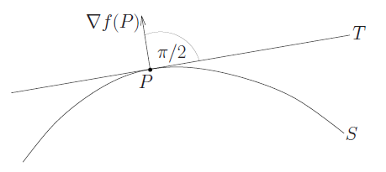
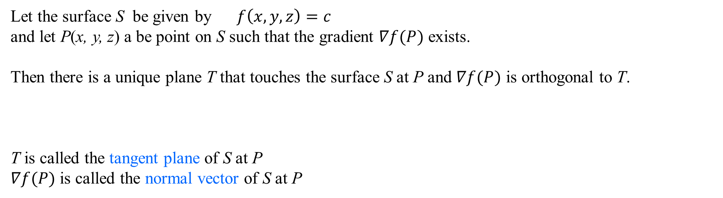
Tangent plane and normal vector
Let the surface S be given by $f\left(x,y,z\right)=c$
and let P(x, y, z) a be point on S such that the gradient $∇f(P)$ exists.
Then there is a unique plane T that touches the surface S at P and $∇f(P)$ is orthogonal to T.
T is called the tangent plane of S at P
$∇f(P)$ is called the normal vector of S at P

Slide 18


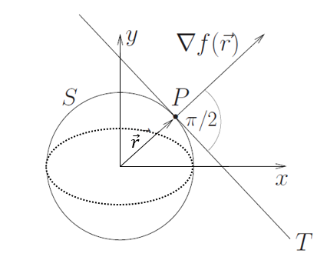
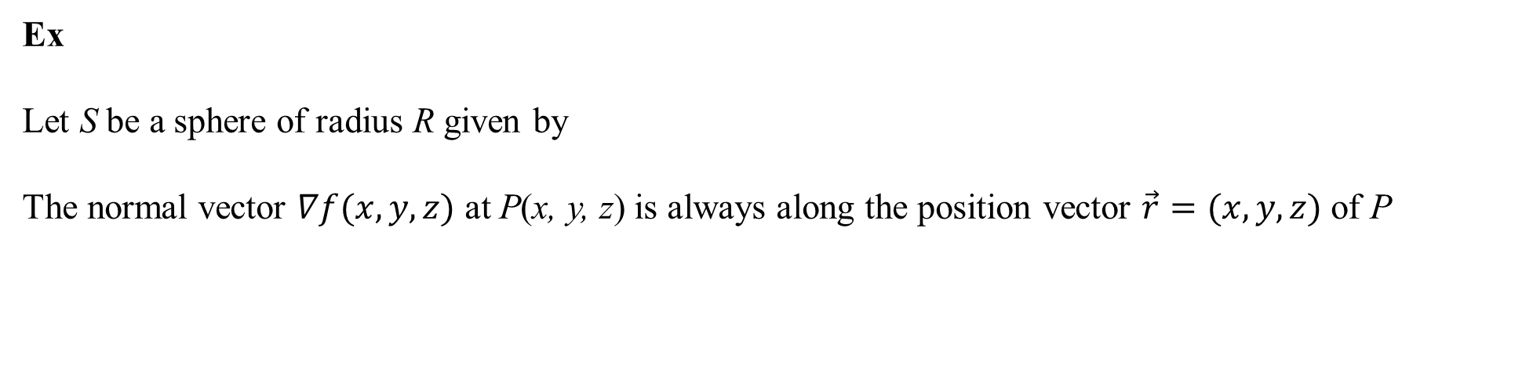
Tangent plane and normal vector
Ex
Let S be a sphere of radius R given by
The normal vector $∇f(x,y,z)$ at P(x, y, z) is always along the position vector $\vec{r}=(x,y,z)$ of P
J. Schmiegel: Lecture notes

Slide 19


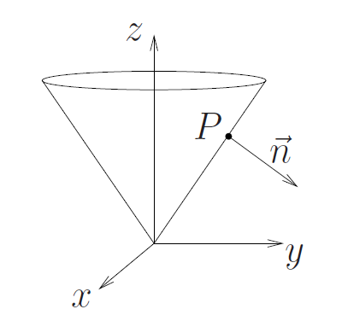
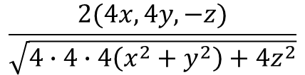
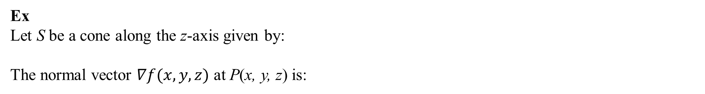

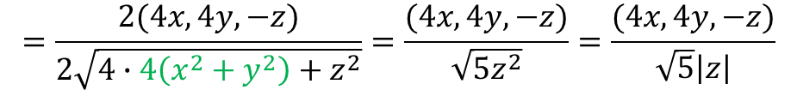
Tangent plane and normal vector
Ex
Let S be a cone along the z-axis given by:
The normal vector $∇f(x,y,z)$ at P(x, y, z) is:
The unit surface normal vector $\vec{n}$ is defined by:
$$\frac{2(4x,4y,−z)}{\sqrt{4∙4∙4\left(x^{2}+y^{2}\right)+4z^{2}}}$$
$$=\frac{2(4x,4y,−z)}{2\sqrt{4∙4\left(x^{2}+y^{2}\right)+z^{2}}}=\frac{(4x,4y,−z)}{\sqrt{5z^{2}}}=\frac{(4x,4y,−z)}{\sqrt{5}\left|z\right|}$$
J. Schmiegel: Lecture notes

Slide 20


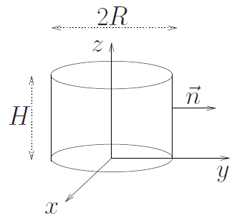

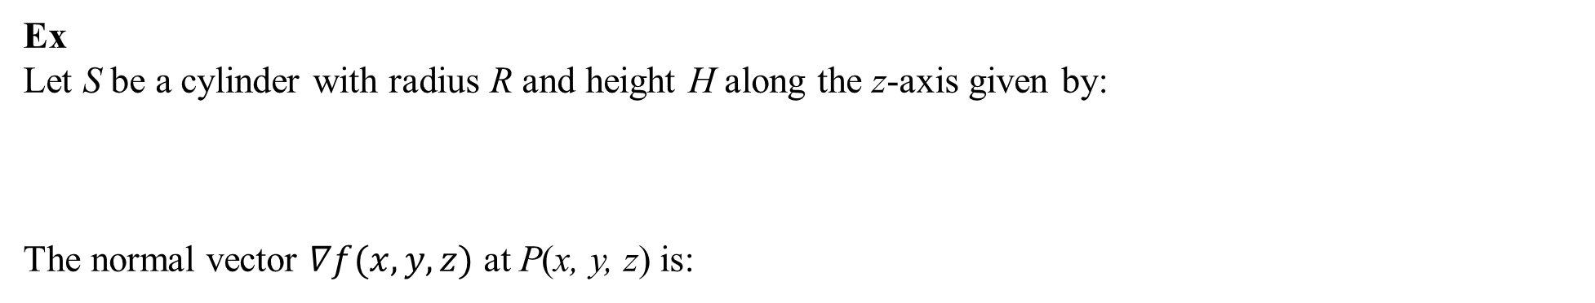
Tangent plane and normal vector
Ex
Let S be a cylinder with radius R and height H along the z-axis given by:
The normal vector $∇f(x,y,z)$ at P(x, y, z) is:
The unit surface normal vector $\vec{n}$ is given as:
J. Schmiegel: Lecture notes

Slide 21
Vector Calculus
The divergence of a vector field

Slide 22


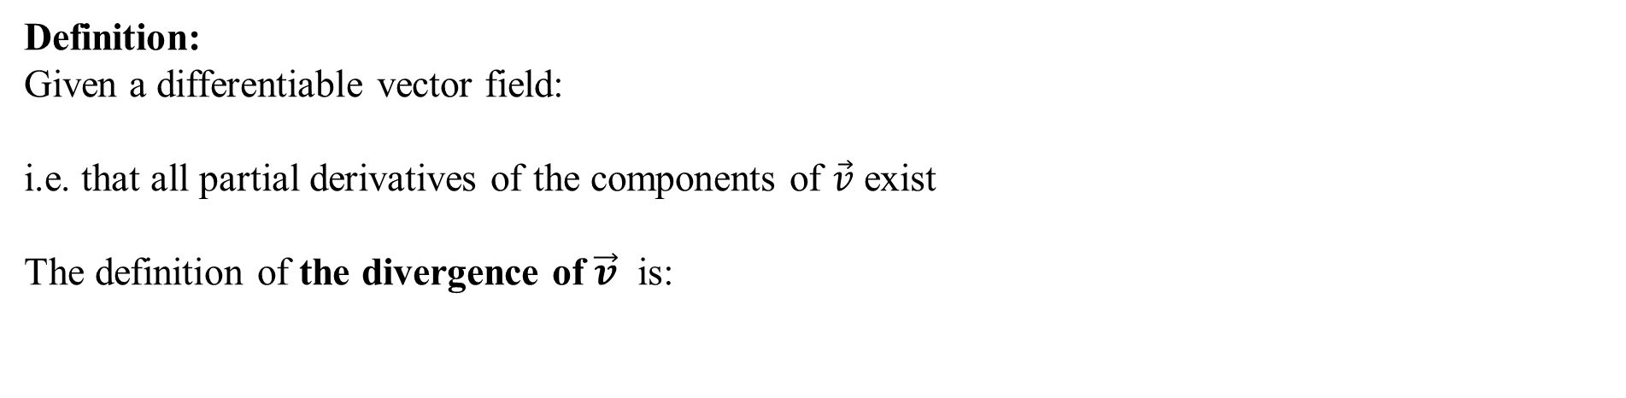
The divergence of a vector field
Definition:
Given a differentiable vector field:
i.e. that all partial derivatives of the components of $\vec{v}$ exist
The definition of the divergence of $\vec{v}$ is:
In terms of the Napla operator it is written:
Note that the divergence of the vector field $\vec{v}$ is a scalar field

Slide 23
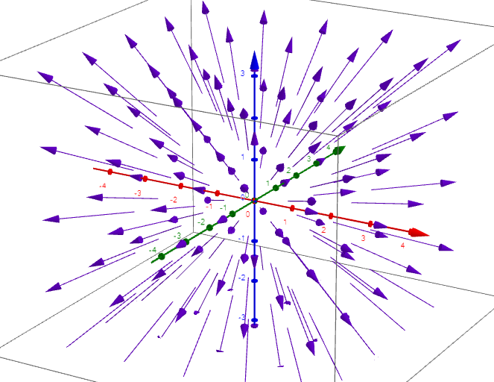
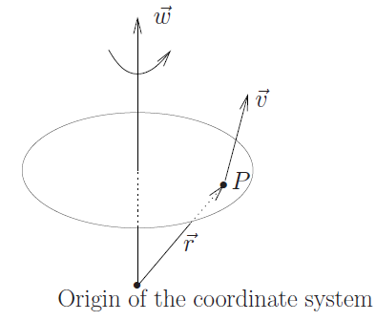
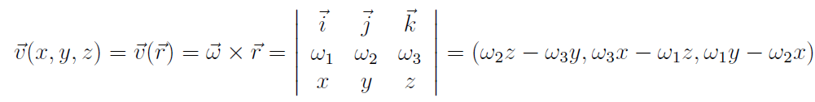
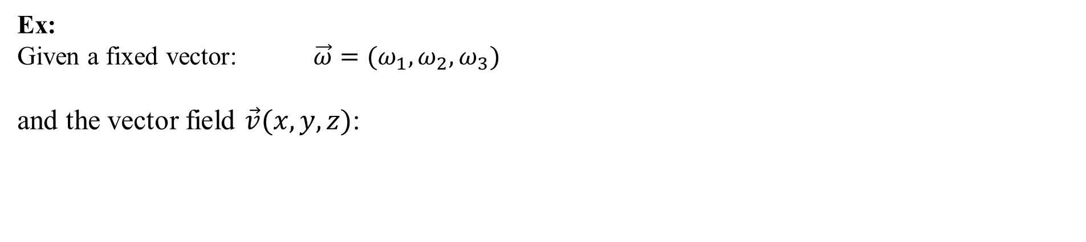
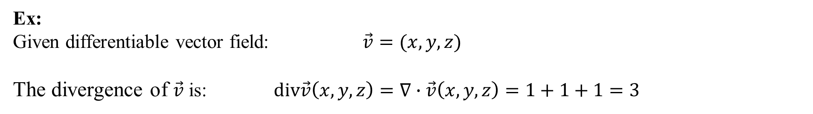
The divergence of a vector field
Ex:
Given differentiable vector field: $\vec{v}=(x,y,z)$
The divergence of $\vec{v}$ is: $div\vec{v}\left(x,y,z\right)=∇∙\vec{v}\left(x,y,z\right)=1+1+1=3$
Ex:
Given a fixed vector: $\vec{ω}=(ω_{1},ω_{2},ω_{3})$
and the vector field $\vec{v}(x,y,z)$:
J. Schmiegel: Lecture notes
Then the divergence of $\vec{v}(x,y,z)$ is: $div\vec{v}\left(x,y,z\right)=∇∙\vec{v}\left(x,y,z\right)=0+0+0=0$

Slide 24



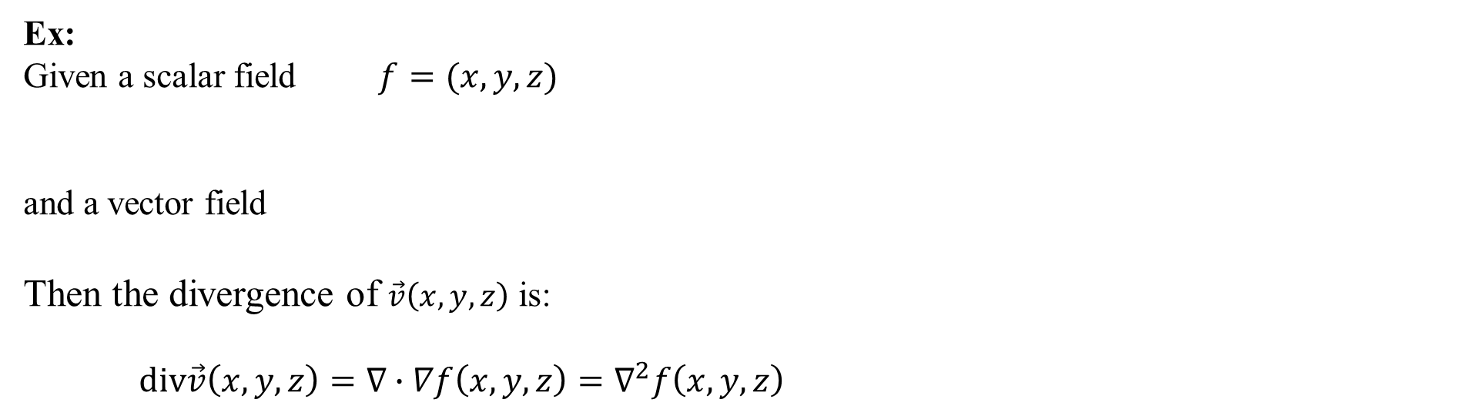
Laplace operator, $∇^{2}$
Ex:
Given a scalar field $f=(x,y,z)$
and a vector field
Then the divergence of $\vec{v}\left(x,y,z\right)$ is:
$div\vec{v}\left(x,y,z\right)=∇∙∇f\left(x,y,z\right)=$ $∇^{2}f\left(x,y,z\right)$
The Laplace operator is defined as: $∇^{2}=∇∙∇$

Slide 25

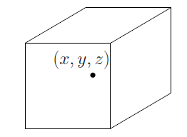




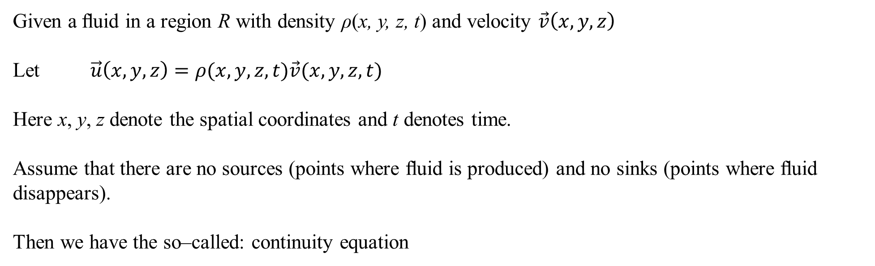
Flow of a fluid
Given a ﬂuid in a region R with density ρ(x, y, z, t) and velocity $\vec{v}\left(x,y,z\right)$
Let $\vec{u}\left(x,y,z\right)=ρ(x,y,z,t)\vec{v}(x,y,z,t)$
Here x, y, z denote the spatial coordinates and t denotes time.
Assume that there are no sources (points where ﬂuid is produced) and no sinks (points where ﬂuid disappears).
Then we have the so–called: continuity equation
If more inﬂow than outﬂow, then and
J. Schmiegel: Lecture notes
If more outﬂow than inﬂow, then and

Slide 26


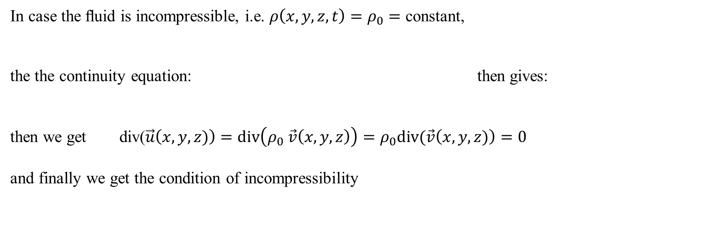
Flow of a fluid
In case the ﬂuid is incompressible, i.e. $ρ\left(x,y,z,t\right)=ρ_{0}=$ constant,
the the continuity equation: then gives:
then we get div($\vec{u}\left(x,y,z)\right)=div\left(ρ_{0} \vec{v}\left(x,y,z\right)\right)=ρ_{0}div(\vec{v}\left(x,y,z)\right)=0$
and finally we get the condition of incompressibility
J. Schmiegel: Lecture notes

Slide 27

Flow of a fluid
In summary:
The divergence of $\vec{u}\left(x,y,z,t\right)$ measures outﬂow minus inﬂow.
If more inﬂow than outﬂow, then
If more outﬂow than inﬂow, then
J. Schmiegel: Lecture notes

Slide 28


We are doing exercises from lecture notes 2

